Slide 1

Customer Shopping Behavior Analysis
A comprehensive data-driven exploration of 3,900 purchase transactions to uncover spending patterns, customer segments, and strategic opportunities for business growth.

Slide 2
Dataset Overview
3,900
18
37
Purchase Records
Data Columns
Missing Values
Complete transactional dataset
Rich customer and purchase details
Review ratings imputed
The dataset encompasses customer demographics (Age, Gender, Location, Subscription Status), detailed purchase information (Item Purchased, Category, Purchase Amount, Season, Size, Color), and comprehensive shopping behavior metrics (Discount Applied, Promo Code Used, Previous Purchases, Frequency of Purchases, Review Rating, Shipping Type).

Slide 3
Data Preparation Process
01
02
Data Loading & Exploration
Missing Data Handling
Imported dataset using pandas and conducted initial exploration with df.info() and describe() for structure and summary statistics.
Identified 37 missing values in Review Rating column and imputed using median ratings by product category.
03
04
Column Standardization
Feature Engineering
Rewrote column names to snake case for improved readability and documentation standards.
Created age_group by binning customer ages and purchase_frequency_days from purchase data.
05
06
Data Consistency Check
Database Integration
Verified discount_applied and promo_code_used were redundant; dropped promo_code_used column.
Connected Python script to PostgreSQL and loaded cleaned DataFrame for SQL analysis.

Slide 4
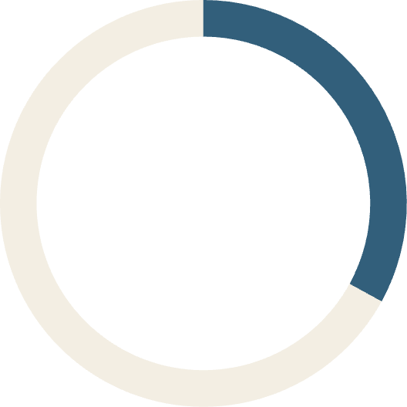

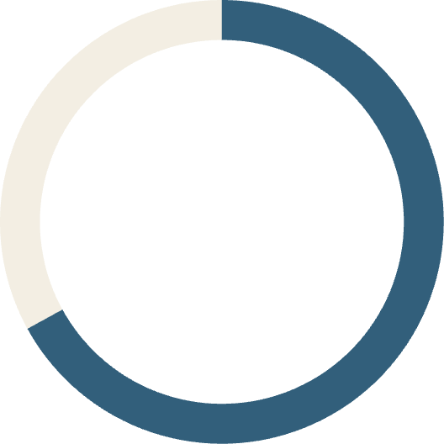
Revenue by Gender Analysis
33%
Female Customers
$75,191 total revenue
67%
Male Customers
$157,890 total revenue
Male customers generated nearly double the revenue of female customers, representing 67% of total sales. This significant disparity suggests potential opportunities for targeted marketing campaigns to increase female customer engagement and spending.

Slide 5
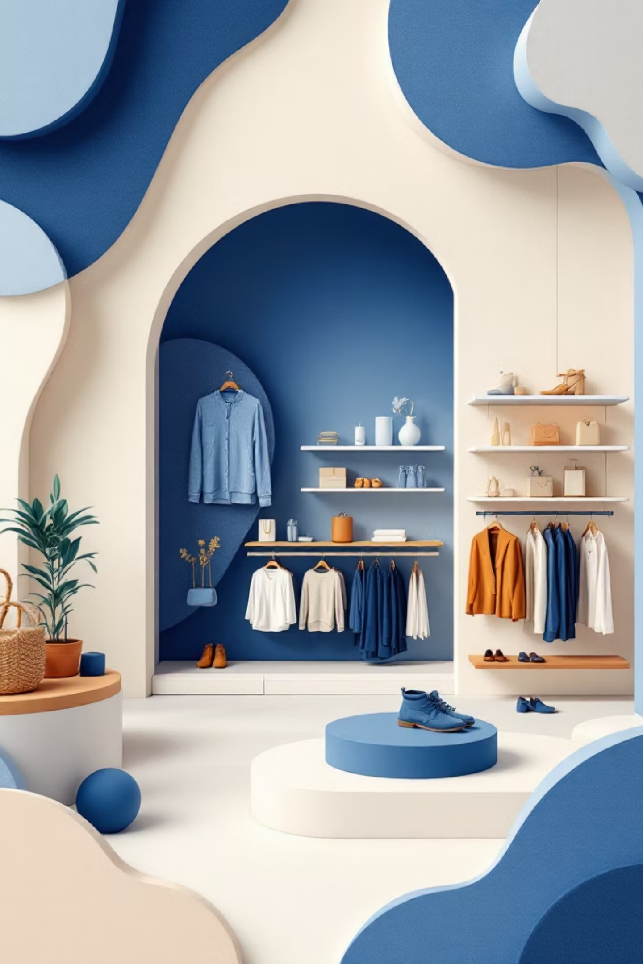

Product Performance Insights
Top Rated Products
Discount-Dependent Items
Gloves (3.86 avg)
Sandals (3.84 avg)
Boots (3.82 avg)
Hat (3.80 avg)
Skirt (3.78 avg)
Hat (50% discounted)
Sneakers (49.66%)
Coat (49.07%)
Sweater (48.17%)
Pants (47.37%)
Shipping Comparison
Standard shipping: $58.46 avg
Express shipping: $60.48 avg
Express customers spend ~3.5% more per purchase.

Slide 6
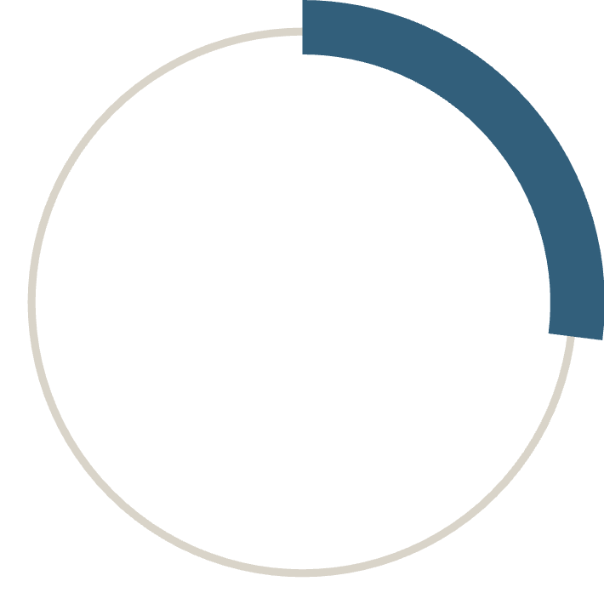
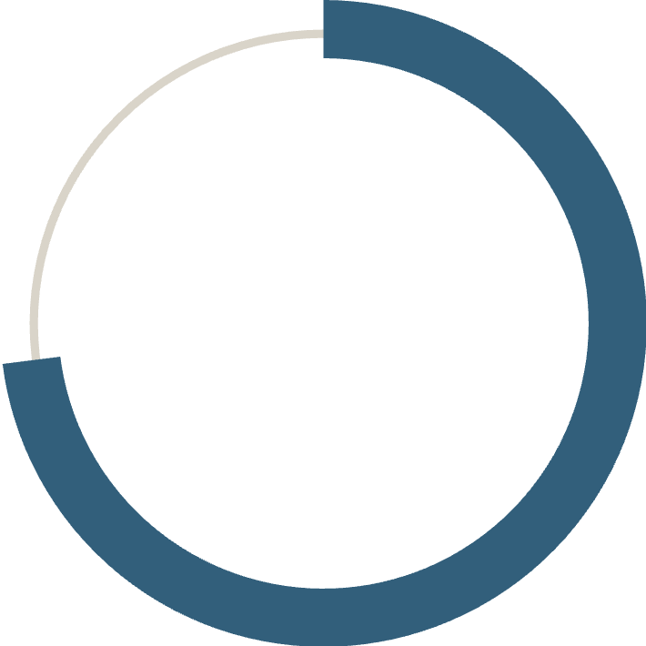
Subscription & Customer Segmentation
27%
73%
Subscribers
Non-Subscribers
1,053 customers with active subscriptions
2,847 customers without subscriptions
Revenue Comparison
Customer Segments
Subscribers: $62,645 total revenue ($59.49 avg)
Loyal: 3,116 customers (79.9%)
Non-subscribers: $170,436 total revenue ($59.87 avg)
Returning: 701 customers (18.0%)
Non-subscribers generate 2.7x more total revenue despite similar average purchase amounts.
New: 83 customers (2.1%)
Strong repeat purchase behavior indicates high customer retention.

Slide 7
Top Products by Category
1
2
Accessories
Clothing
Jewelry (171 orders)
Sunglasses (161 orders)
Belt (161 orders)
Blouse (171 orders)
Pants (171 orders)
Shirt (169 orders)
3
4
Footwear
Outerwear
Sandals (160 orders)
Shoes (150 orders)
Sneakers (145 orders)
Jacket (163 orders)
Coat (161 orders)
Blouse and Jewelry tied for highest individual product orders at 171 each, demonstrating strong performance across both clothing and accessories categories.

Slide 8
Revenue by Age Group
27%
25%
Young Adult
Middle-aged
$62,143 revenue
$59,197 revenue
24%
24%
Adult
Senior
$55,978 revenue
$55,763 revenue
Revenue distribution across age groups is remarkably balanced, with Young Adults leading at 27% of total revenue. This even spread suggests broad demographic appeal and opportunities for age-targeted marketing strategies.

Slide 9
Key Business Insights
Repeat Buyers & Subscriptions
High-Spending Discount Users
Express Shipping Preference
958 repeat buyers (purchases >5) are subscribed vs. 2,518 non-subscribers. Repeat buyers show 38% subscription rate, indicating loyalty program effectiveness.
839 customers used discounts but spent above average ($59.76). Strategic discounting can drive volume without sacrificing revenue quality.
Express shipping customers spend 3.5% more per purchase ($60.48 vs. $58.46). Premium shipping correlates with higher spending behavior.

Slide 10





Strategic Recommendations
Boost Subscriptions
Promote exclusive benefits and incentives to convert 73% non-subscribers. Current subscribers show strong engagement patterns.
Customer Loyalty Programs
Reward repeat buyers to accelerate movement into "Loyal" segment. Current 79.9% loyal customer rate provides strong foundation.
Review Discount Policy
Balance sales boosts with margin control. 50% of hats discounted suggests potential margin pressure on popular items.
Product Positioning
Highlight top-rated products (Gloves, Sandals, Boots) and best-sellers (Blouse, Jewelry, Pants) in marketing campaigns.
Targeted Marketing
Focus on high-revenue age groups (Young Adults) and express-shipping users. Male customers represent 67% of revenue opportunity.

